Slide 1
Readying your campus for coronavirus
Chuck Staben, Ph.D.
Professor of Biological Sciences President, University of Idaho 2014-2019
cstaben@uidaho.edu

Slide 2
Background
Biochemistry PhD
(HIV virology)
Faculty member/Department Chair-UK
Associate/Acting VP Research-U. Kentucky
Provost-U. South Dakota
President-U. Idaho (2014-2019)
Inside Higher Education article-Feb 27
https://www.insidehighered.com/views/2020/02/27/how-college-leaders-should-prepare-their-campuses-coronavirus-opinion

Slide 3
Audience Poll
Using the chat feature, please let us know who is participating from your institution today.
Administrator
Academic Advising
Admissions/Enrollment Management
Student Affairs
Faculty
Other (please specify)
Audience Poll

Slide 4
Covid-19 Readiness Webinar
Situation
Containment
Mitigation
Longterm consequences
Share experiences and thoughts

Slide 5
Coronavirus and Covid-19
>120,000 cases; >4000 deaths worldwide
Morbidity and Mortality
Underlying medical conditions Smoking, gender, age…
Transmission
Person-person close contact is primary
Droplets
Possibility of surface contact transmission
NIAD-RML

Slide 6
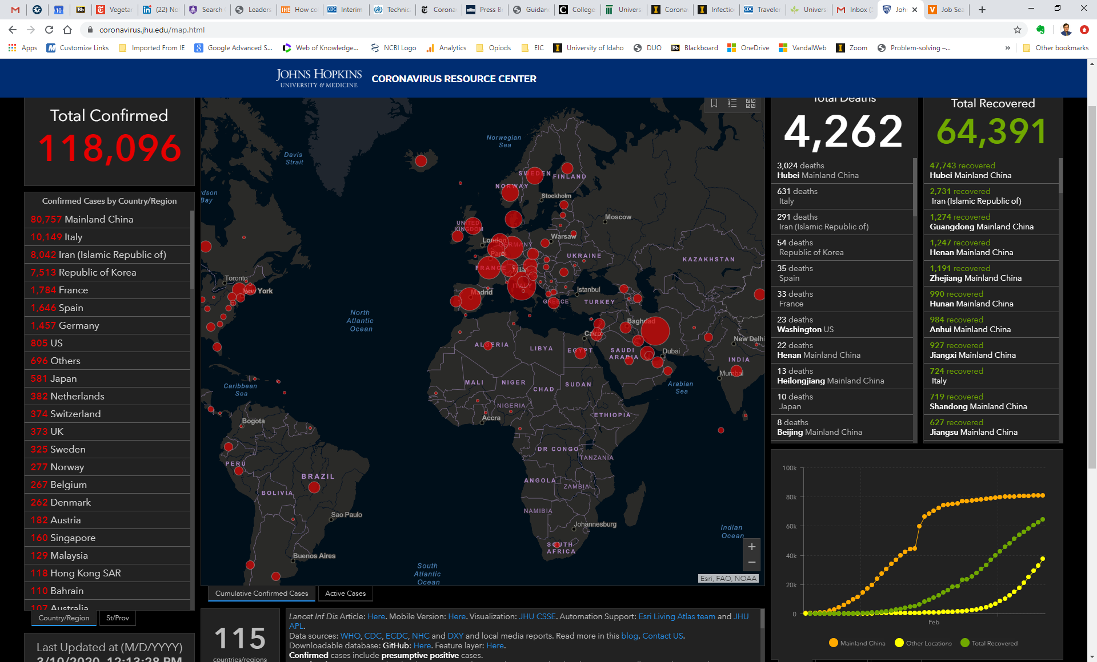
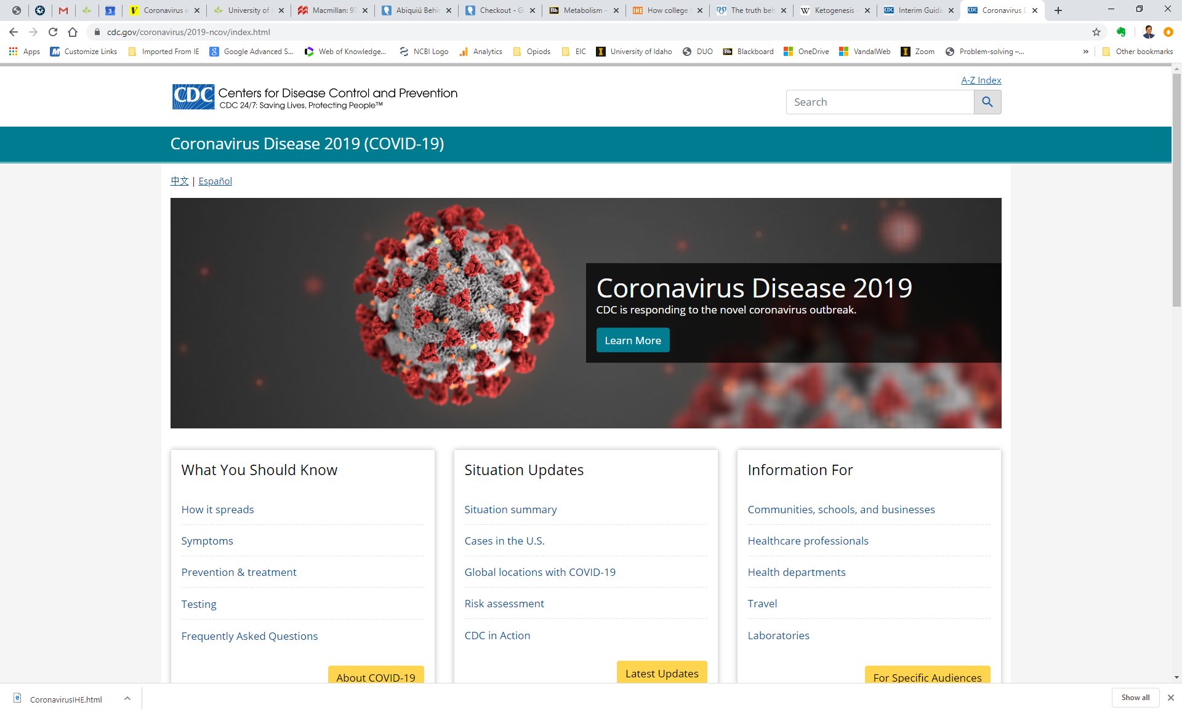
Covid-19 in the US
>1000 cases
>35 states
>25 deaths
Washington cluster
https://coronavirus.jhu.edu/map.html

Slide 7
What did WHO learn from China?
SPEED of response key
Traditional public health measures useful
Stop large public gatherings-decrease transmission
Segregate the sick (fever hospitals)
Population infection rate is low (0.5% in Guangdong)
Use population-level measures
Educate about symptoms/surveillance
Hygiene-Wash your hands, cover your cough
Isolate yourself if ill
Ready communication-emergency line/website…don’t send people to clinic

Slide 8
Additional China “lessons”
Testing and treatment free→encourage usage
Prepare the health system
Access to prescriptions, hospitals
Plenty of PPE
Respirators

Slide 9
What are the key symptoms?
Runny Nose
Fever
Sore throat
Dry Cough
Shortness of breath
Vomiting
Diarrhea
Sneezing
Cold?
Flu?
Covid-19?
Audience Poll

Slide 10
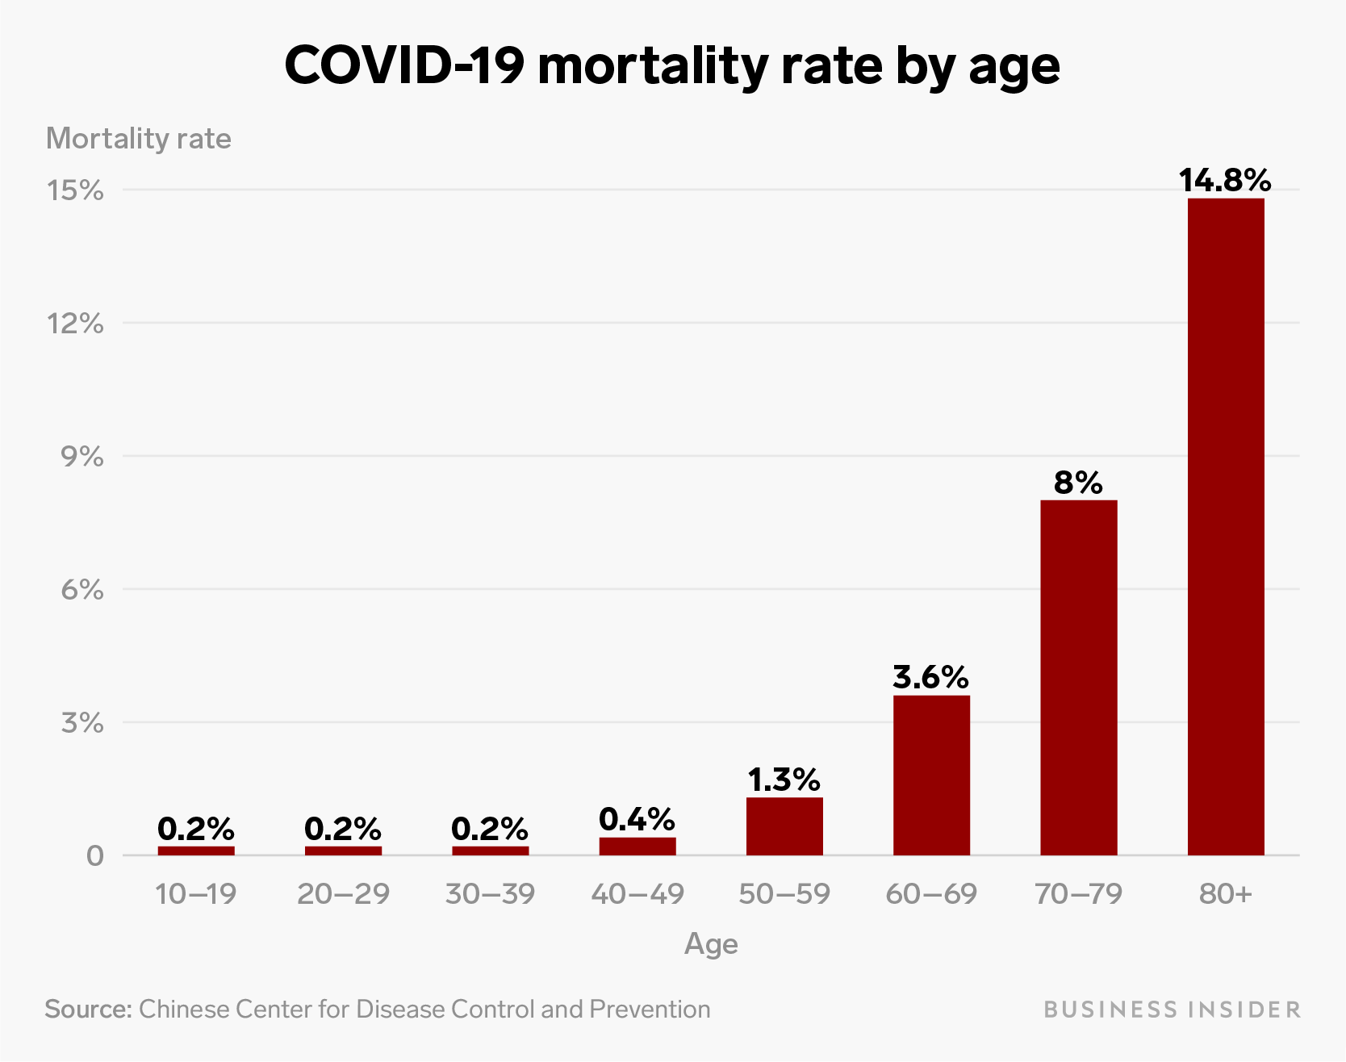
Possible Impact-Mortality
Preliminary data from China
Overall 3.4%
Deadlier than flu
Age
Heart disease Lung disease Diabetes

Slide 11
Burden of seasonal flu (2018-19)
35.5 million infected (~10%)
16.5 million healthcare visits
500,000 hospitalizations
34,000 deaths
Age | Mortality
18-49 | 0.0018%
50-65 | 0.009%
65+ | 0.05%
Comparison?

Slide 12
Potential Mortality Impact “Typical” Residential Campus
Population | Age | Mortality | Number | 1% inf | 10%
Students | 20-29 | 0.2% | 10,000 | 0.2 | 2
Staff | 20-29 | 0.2% | 300 | 0.006 | 0.06
 | 30-39 | 0.2% | 300 | 0.006 | 0.06
 | 40-49 | 0.4% | 400 | 0.016 | 0.16
 | 50-59 | 1.3% | 300 | 0.039 | 0.39
 | 60-69 | 3.6% | 200 | 0.072 | 0.72
Morbidity will be higher
Students pose threat to older staff?!
76 million K12, 20 million college students

Slide 13
US Mortality Estimate* *Based on Chinese mortality data
Age group | Population | Mortality | 1% infected | 10% infected
0-9 | 40,000,000 | 0.002 | 800 | 8000
10 to 19 | 42,000,000 | 0.002 | 850 | 8400
20 to 29 | 45,500,000 | 0.002 | 900 | 9100
30-39 | 44,000,000 | 0.002 | 900 | 8700
40-49 | 40,500,000 | 0.004 | 1600 | 16,200
50-59 | 43,000,000 | 0.013 | 5600 | 55,700
60-69 | 37,500,000 | 0.036 | 13,500 | 135,000
70-79 | 23,000,000 | 0.08 | 18,400 | 184,000
80+ | 12,500,000 | 0.148 | 18,800 | 188,000
Total deaths |  |  | 61,300 | 613,000

Slide 14
Guidance Documents
CDC Guidance
Covid-19 NOT yet present in community
Covid-19 PRESENT in community
Department of Education
American College Health Association
APLU List
U. Washington

Slide 15
Incident Command System
FEMA
https://training.fema.gov/emiweb/is/icsresource/index.htm
Used by police, etc
Not common at universities

Slide 16
Key preparedness
Disease prevention and surveillance
Education
Communication/consultation
Health system preparedness
Emergency Response preparedness
University preparedness
Prepare for isolation, social distancing
Prepare for disruption, adaptation
Identify any special capacity

Slide 17
CDC recommendations
Update plans, form working groups, partner with local health authorities
Positive communications on hygiene, surveillance
Access to hand sanitizer? Thermometers?
Establish, communicate procedures for sick students or staff
Prepare student health clinic
(Prepare residence hall and food service staff)
Continue routine environmental maintenance

Slide 18
CDC: Covid-19 PRESENT
Coordinate with health officials on
Cancelling face-face classes
Cancelling mass gatherings
Safe housing (on campus, off, sending home)
Safe dining
Avoid stigmatizing
Ensure continuity of education
Streaming
Learning Management System
Ensure continuity of research
Animal care, facilities safety

Slide 19
Dept. Education-key changes
Financial aid issues (analysis by NASFAA)
Broad approval of distance education, waiving need for accreditor approval to comply with financial aid requirements
Relaxing consortium requirements
Continuing Work-Study flexibly
Flexibility on disruption of Study Abroad

Slide 20
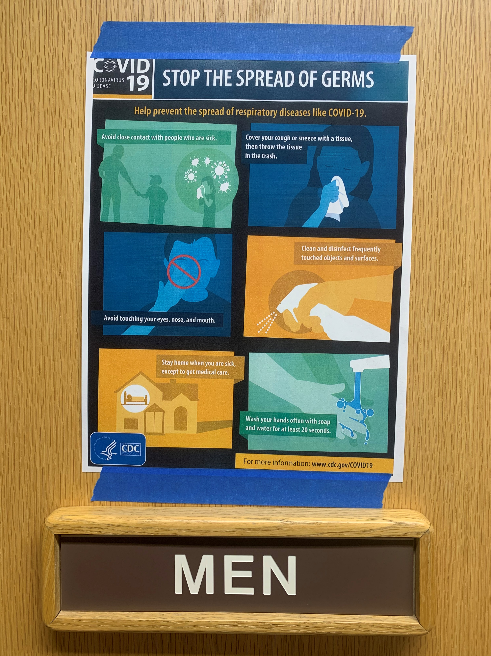
Preventive Communications
Hygiene reminders
Symptom Surveillance
“Hotline”, Webpage, Emails, postings…
Audiences
Students, staff, residence hall

Slide 21
Communication
ONE Voice, one authority for university
Website
Physical postings
Email
Text alerts
Time for a spring break message?
Be alert for travel restrictions
Take home any vital materials such as texts, medicines…
Will advise whether students can or should return to campus
How do we address MISinformation?

Slide 22
Study/Research Abroad
Repatriate students from abroad
All countries?
Travel Advisory countries
Quarantine (home, on campus)
Recall faculty?
China-Level 3
Italy-3
Iran-3
South Korea-3
Japan-Level 2
Hong Kong-Level1

Slide 23
CDC Travel Recommendation
https://www.cdc.gov/coronavirus/2019-ncov/travelers/after-travel-precautions.html

Slide 24
CDC Self Isolation-14 days
Take your temperature with a thermometer two times a day and monitor for fever. Also watch for cough or trouble breathing.
Stay home and avoid contact with others. Do not go to work or school for this 14-day period. Discuss your work situation with your employer before returning to work.
Do not take public transportation, taxis, or ride-shares during the time you are practicing social distancing.
Avoid crowded places (such as shopping centers and movie theaters) and limit your activities in public.
Keep your distance from others (about 6 feet or 2 meters).

Slide 25
Mitigation, Minimizing Disruption
Containment, mitigation similar initiatives
Preparedness flattens the curve
Minimize damage, danger to public
Social distancing

Slide 26
Moving Classes Online
Dept. of Education Temporary Rules (It’s OK!)
Technical and pedagogic challenges
Live streaming
Skype, Zoom…licensing limitations?
Bandwidth issues (throttle video streaming or gaming…but that is what students will want to do!)
Asynchronous video
Quality, quantity (eg. Blackboard server limits)
Internet access-student and faculty member
Pegagogic support/Faculty access (internet, resources)
Laboratory classes, Art, Music, Theater…
Online exams/Proctoring?

Slide 27
Online Classes-thoughts
Start NOW
DON’T use scattershot technologies-nightmarish to learn for faculty, students, IT support
Standardize, template, systematize
Institutional (guidance)-mandate? Work with Faculty Senate, emphasize student learning and faculty support
Start with live, online…move to incorporate chats, asynchronous content…etc for the novice instructor
Exams→projects (eliminates proctoring)

Slide 28
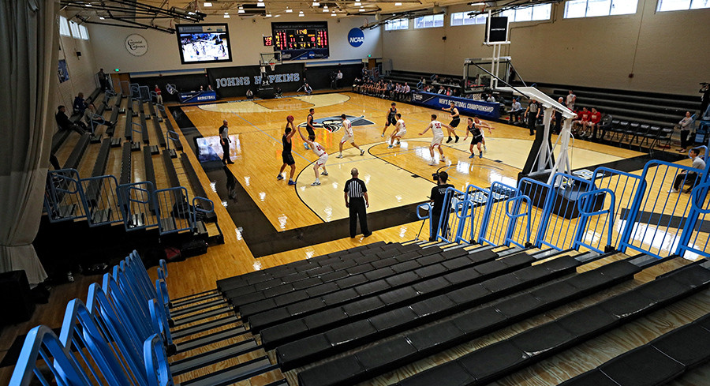
Athletics, Concerts, Events
Trigger to cancel-coordinate with health authorities?
Continue without spectators? Reschedule?
Necessary travel?
NCAA guidance
Johns Hopkins D3 tournament no spectators

Slide 29
American College Health Association
Structure preparation, response team
Train staff
Prepare for triage and isolation
Stock PPE
Assess, improve environmental infection control
Develop surge care plan
Coordinate communications
Avoid stigmatization, panic

Slide 30
Suspect Case Protocol
What does potentially infected student/staff/faculty member do?
DO NOT take public transit to a clinic-example!
Call ahead to clinic
Health system (probably informed)
Residence staff
General staff

Slide 31
Feeding campus students
Meal delivery to rooms
Infected students
All students?
“Grab and go” safer?
Disrupted food distribution systems in college towns?
How much food do you have on hand?
Have you talked with your dining services provider (Aramark, etc?)?

Slide 32
International students
May NOT be able to “return home”
Your campus may be their home
Dept. Homeland Security-international students can take online classes w/o jeopardizing visa status
Many international students may travel home, not be able to return
May be more isolated, less support system, more fearful

Slide 33
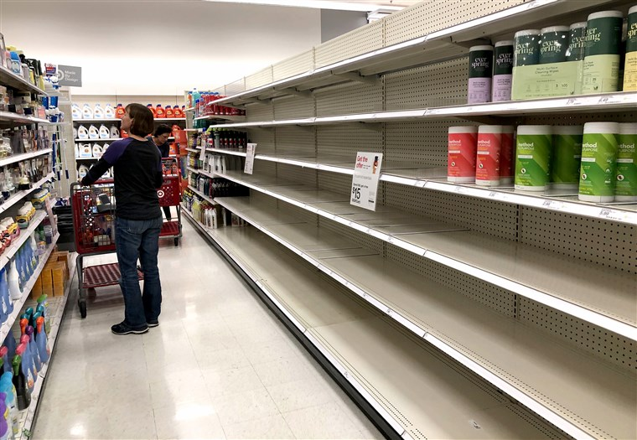
Essential Functions/Disruptions On and Off Campus
Food
Maintenance
Laboratory Animals/Farm
Public Safety
Food supplies
PPE
Medications-1 month
Access to medical care (non-Covid)

Slide 34
HR/Staff Issues
Monitor/Deal with Absenteeism
Sick leave
Hourly, low-wage workers particularly sensitive
Liberalize policies?
Coronavirus testing/care covered by health plan?
Students
Staff
Working conditions/expectations
Must food service workers come in?
Older workforce/requiring class attendance?

Slide 35
Contractual Concerns
Tuition/Canceled classes or programs
Travel-reschedule/refund
Faculty duties/extension of school year
Events-cancellation or disruption
Vendors
Food/housing disruptions or costs
Deliveries/maintenance of operations

Slide 36
Higher Ed Disruptions in US
U. Washington, Stanford, Harvard…>90 institutions cancelling or going online
Study Abroad-many/most schools recalling students
Conferences: ACE, American Assoc. Community Colleges CANCELLED
Public events cancelled: SXSW, campaign events…

Slide 37
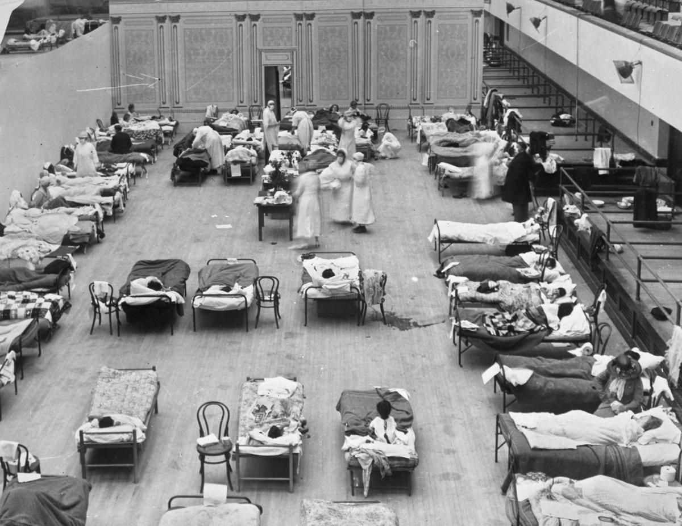
IHE Special Capabilities
Academic Medical Centers
Patient Care
Communication (Public and provider)
Extension offices
Facilities
Vacant dormitories?
Gymnasiums

Slide 38
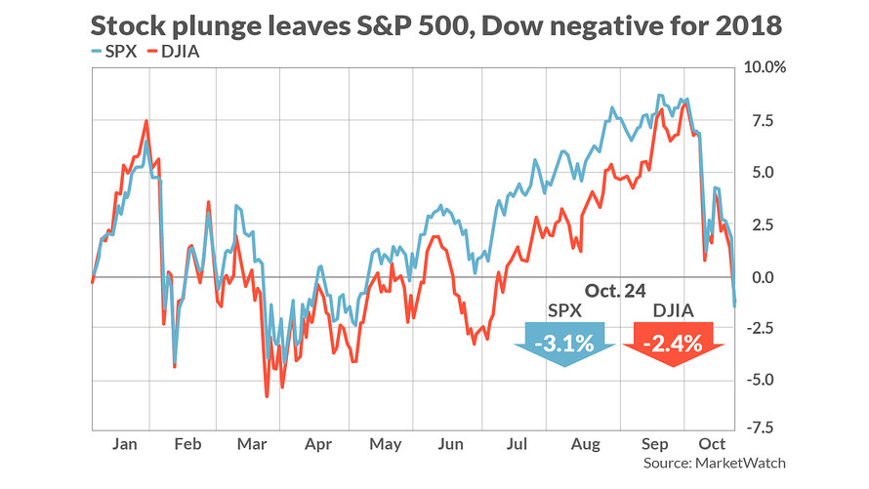
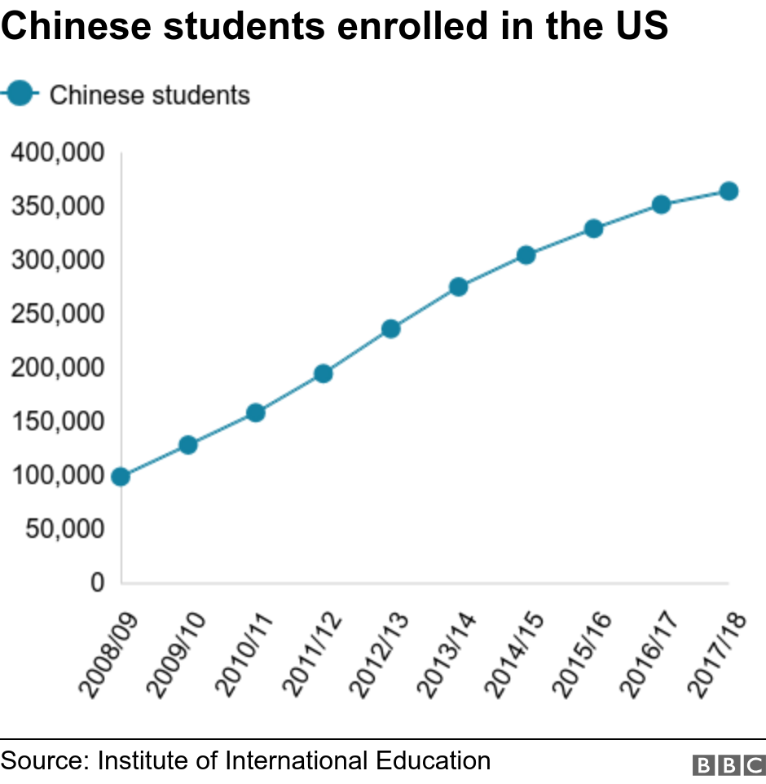
Long Term Issues
Costs of response
Financial downturn
Endowments, other impacts?
Ability to enroll international students (especially Chinese)
Political risk insurance
Changed expectations?
Distance education
Emergency management

Slide 39
How has your campus prepared for or reacted to Covid-19?
No formal or central planning
Planning within divisions, like student health, but not central
Committees and taskforces active on many levels
Using ICMS throughout university
Coordinating with local health authorities
Posted guidance on hygiene, surveillance
Moved classes online, using social distancing
Recalled study abroad students
Audience Poll

Slide 40
Sample Chat Question
What are your biggest problems/concerns with coronavirus preparedness?

Slide 41
Chuck Staben
Professor of Biological Sciences
cstaben@uidaho.edu

